Slide 1

Yale
Using administrative data and synthetic controls to evaluate interventions
Dan Weinberger, PhD
Assistant Professor
Yale School of Public Health

Slide 2
Today
Special challenges when using administrative data for surveillance
What are appropriate control time series and how can they be used?
The synthetic controls method

Slide 3
Spectrum of surveillance types
Active, population-based
Passive administrative data
High-quality
Costly
Requires large teams
Good information on denominators
Variable quality
Cheap
Timely
Denominator sometimes unclear
The Gambia DHSS, US ABCs system
Chilean, Brazilian hospital discharge databases

Slide 4
What do we mean by ‘administrative’ data
Data are collected routinely as part of healthcare delivery
Often for billing purposes or enumeration of official statistics
Available in a standardized electronic format
Paper log books and discharge registers are also ‘administrative’ data, but we won’t cover that today…

Slide 5





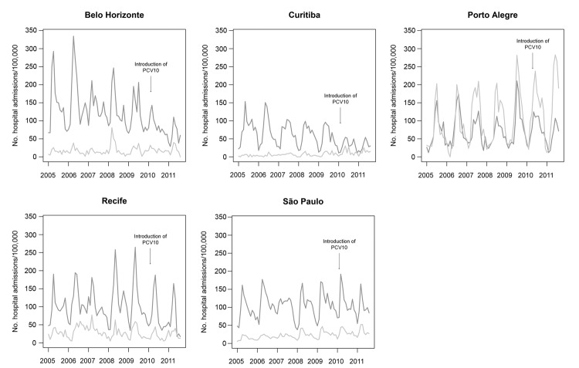
Using administrative data to detect “pneumonia”
ICD-10
Syndromic
case definition
Afonso, et al.

Slide 6
Advantages of administrative data
Ability to rapidly, cheaply collect data on large populations
Can easily stratify analysis into sub-regions
Can readily extract “comparator” diseases to evaluate trends
But…
Often non-specific cases definitions
Need to control for changes in healthcare utilization and other biases
Need to use caution when interpreting and comparing between systems

Slide 7
What does a diagnostic code for ‘pneumonia’ (J12-J18) mean?
Probably somewhere between ‘clinical pneumonia’ and ‘radiologically-confirmed pneumonia’ in terms of specificity
Ideally want to distinguish hospital-acquired pneumonia from community-acquired
First DX code vs later codes
Definitions differ between systems; e.g., admission criteria for pneumonia could differ by country

Slide 8
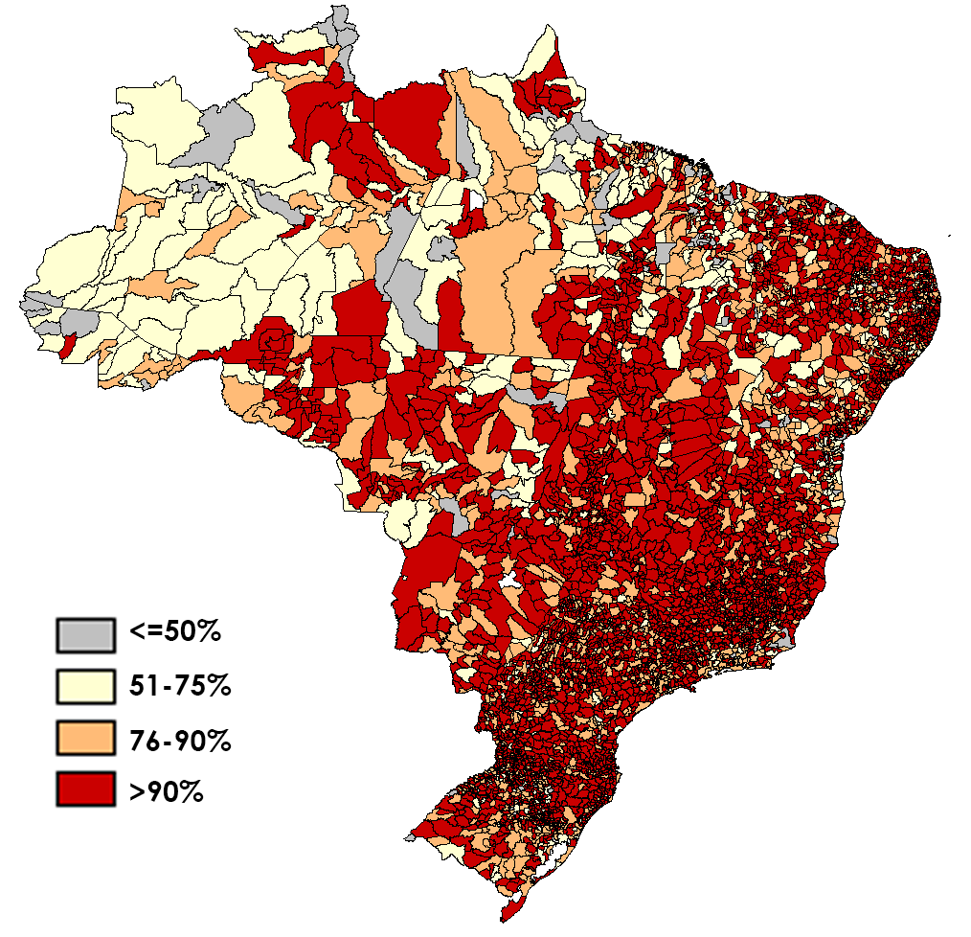
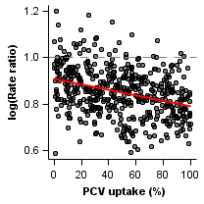
Potential uses of administrative data for evaluating vaccine impact
Time series analysis
Spatiotemporal analysis
Vaccine Introduced
Pneumonia
X% decline
Pre-vaccine
Post-vaccine
Time
Pneumonia rate
Time (months)

Slide 9
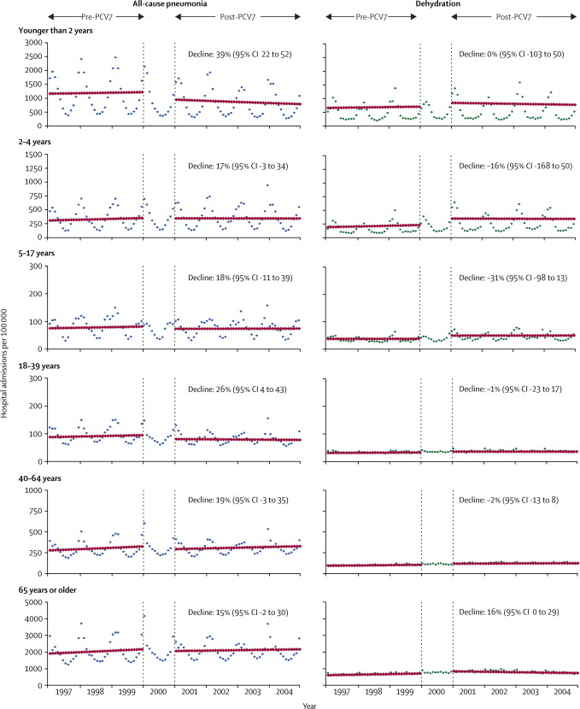
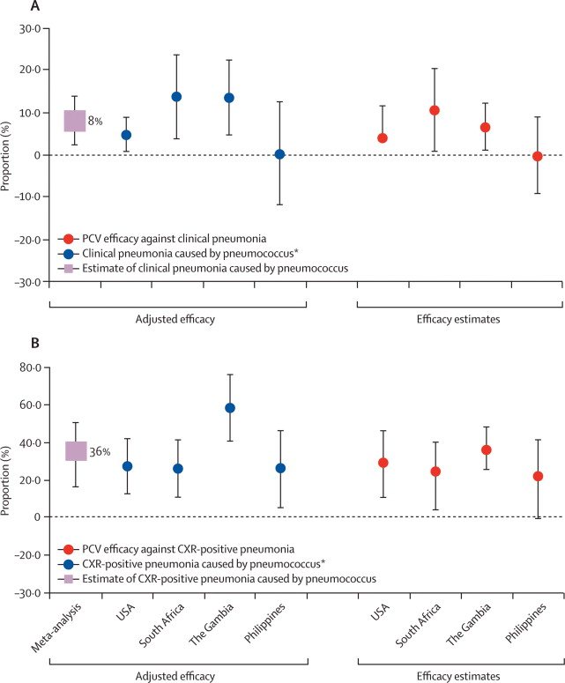
Why should you be skeptical of these types of analyses?
How much can the changes in all-cause pneumonia be attributed to PCV?
Trend studies: Variability; up to 40% declines
RCTs: ~8% Efficacy
Grijalva, The Lancet 2007
(Brazil)
2-23 month olds
-40.3%
Afonso, 2013 EID
O’Brien et al, The Lancet

Slide 10
How can we strengthen confidence in estimates from trend studies?
Comparators
More robust time series analysis
Use of sub-national data for analysis

Slide 11
Use control diseases to detect/adjust for unrelated trends
Vaccine
Often used qualitatively
“Pneumonia declines but UTI is stable”
Can be used quantitatively
“Effect of PCV against pneumonia is X%-Y%”
Pneumonia
X% decline
Pre-vaccine
Post-vaccine
Time
Y% decline
Control disease
(e.g.UTI)
Pre-vaccine
Post-vaccine
Time

Slide 12
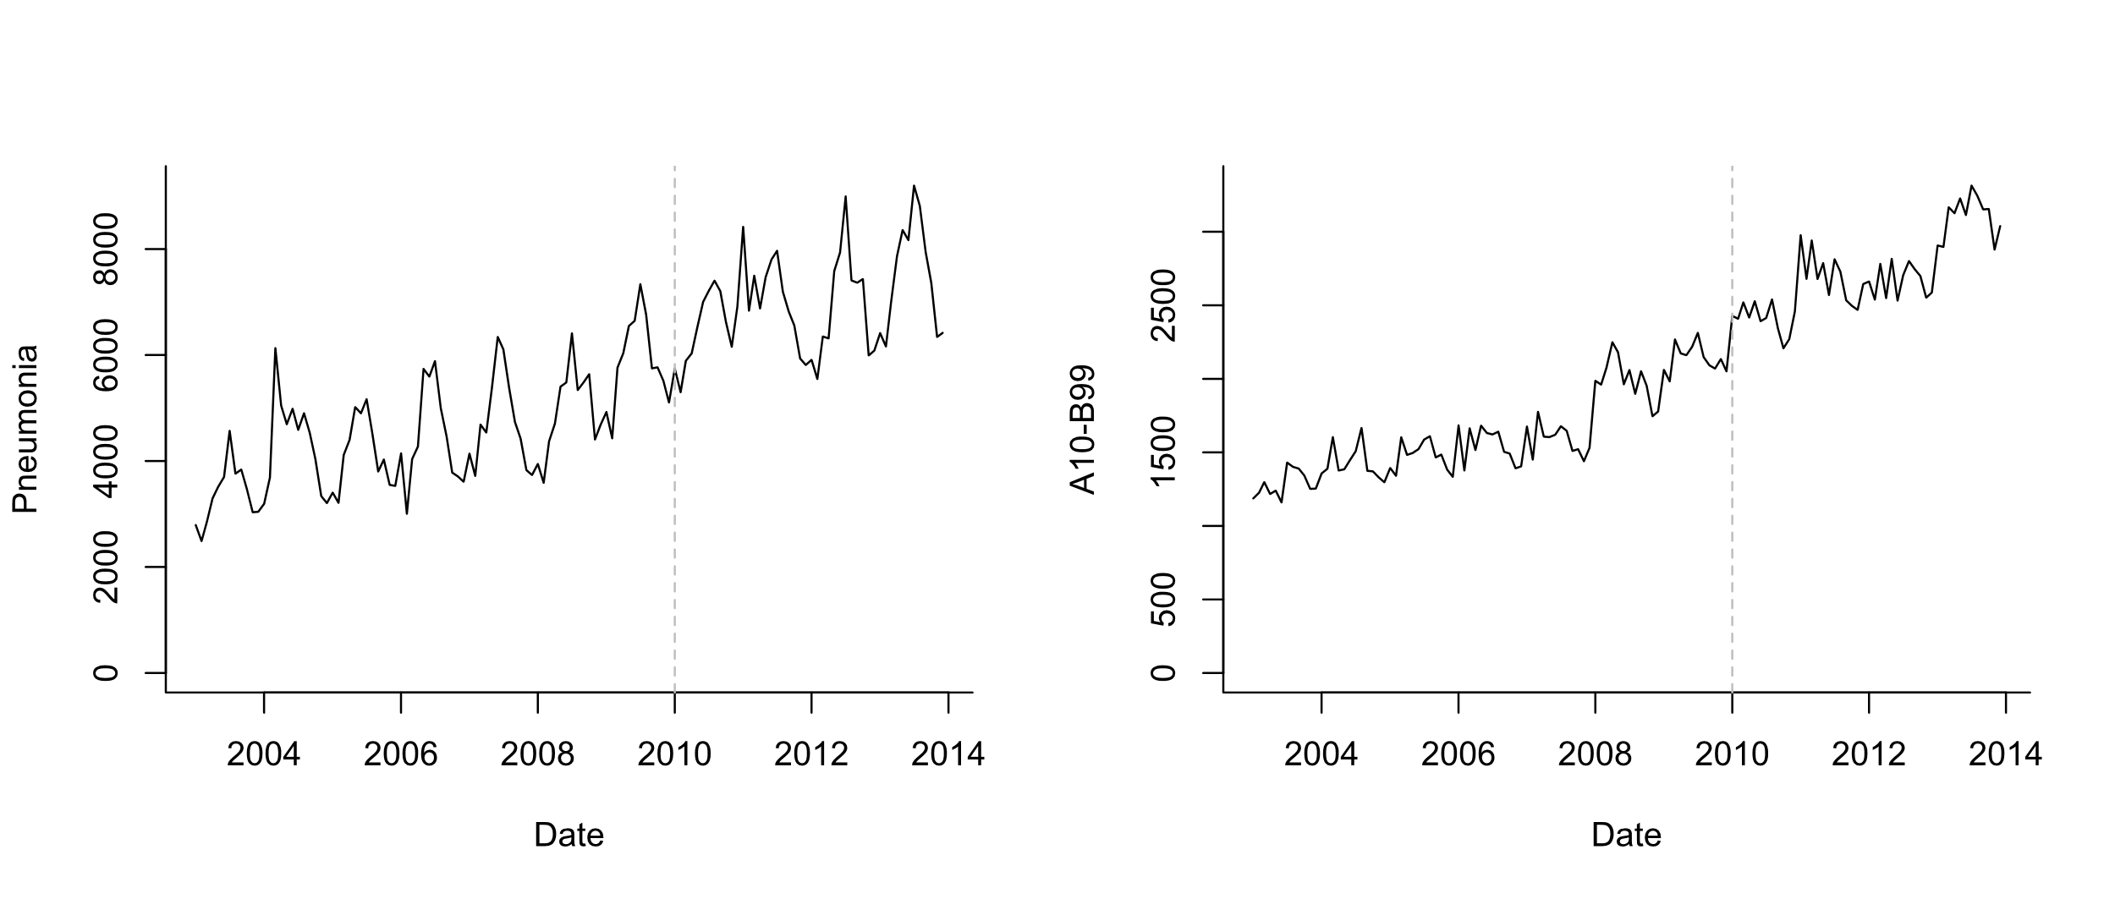
Possible control for pneumonia
Infectious causes (exclude J codes, diarrhea)

Slide 13
How does it work?
Control disease
Model fit
Pneumonia
Pre-vaccine
Post-vaccine
Time
Step 1: Fit a regression model using data from the pre-vaccine data to establish a
relationship between pneumonia and a control disease
E.g., log(pneumonia)= b0 + b1*log(control disease)

Slide 14
How does it work?
Control disease
Model fit
Pneumonia
Pre-vaccine
Post-vaccine
Time
Step 2: Plug in observed values for control disease from post-vaccine period to get an estimate for what counts of pneumonia would be

Slide 15
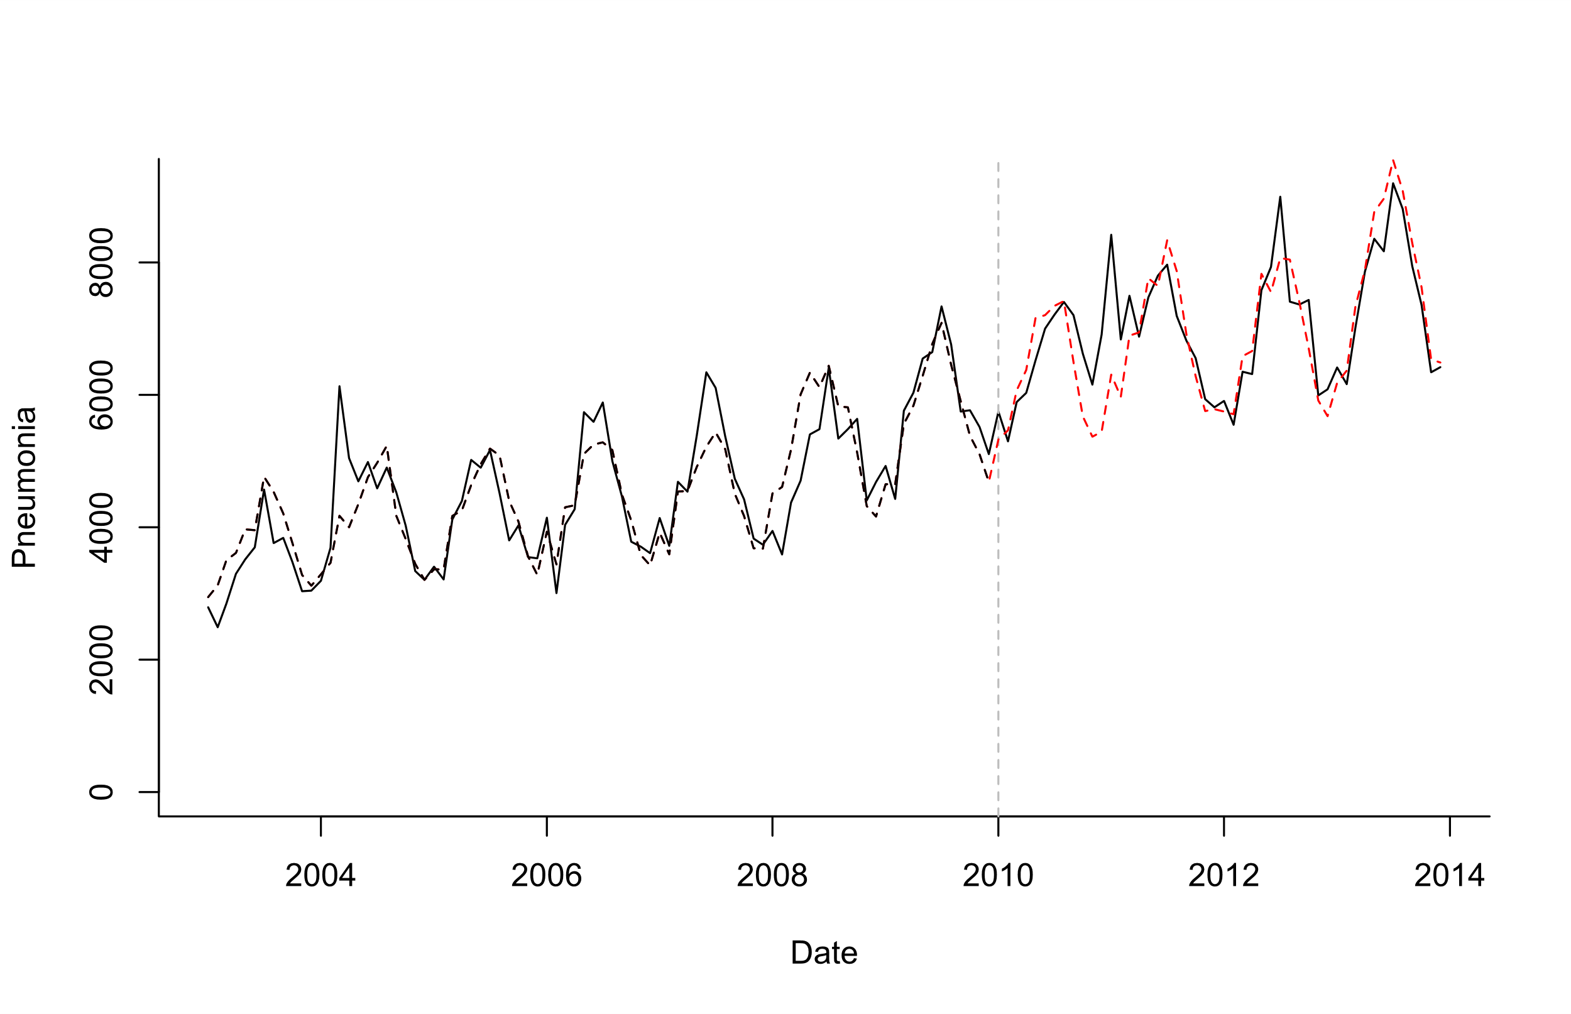
Possible control for pneumonia
Log(Pneumonia)=b0 +b1*sin12 +b2*cos12 +b3*log(A10_B99)
Model Fitting
Extrapolation based on controls

Slide 16
Key Assumptions
Relationship between pneumonia and control is stable over time and only change is due to the vaccine
Violated if there is an intervention that influences the control
Assumes control disease shares important non-vaccine trends with pneumonia
Vaccine does not affect control

Slide 17
What is a good control for pneumonia?

Slide 18
Principles for selecting candidate controls
Exclude any that could plausibly be influenced by the vaccine (e.g. pneumococcal/streptococcal septicemia)
Relationship should be stable over time (e.g. exclude diarrhea following rotavax)
Exclude covariates with sparse data (<10 cases/month on average)

Slide 19
Principles for selecting candidate controls
Exclude any that could plausibly be influenced by the vaccine (e.g. pneumococcal/streptococcal septicemia)
Relationship should be stable over time (e.g. exclude diarrhea following rotavax)
(Exclude covariates with sparse data (<10 cases/month on average))

Slide 20
Letting the data select controls
Method developed by Google for website analytics (Brodersen)
Select large number of candidate controls a priori
Use “automatic” Bayesian variable selection to give more or less weight to specific control diseases in the final model
Log(Pneumonia)=b0 +b1*sin12 +b2*cos12 +b3*control1+ b4*control2+ b5*control3…

Slide 21
What does synthetic controls do?
Outcome
(all-cause pneumonia hospitalizations)
ICD-10: J12-18
Control diseases
Various ICD-10 codes
34 diseases
(Children <12 mo in Brazil is used as an example)

Slide 22
What does synthetic controls do?
Fit regression model to pre-vaccine data only
Test different control variables alone or in combination
In forward or backward variable selection, you would drop less important variables
With this approach (Bayesian variable selection), you never drop any variables, you just give them more weight
Gives you a regression model with a set of controls that do the best job at explaining trends in pneumonia pre-PCV
Extrapolate to post-PCV period based on changes in the control variables

Slide 23

Brodersen et al. Annals of Applied Statistics

Slide 24
Brodersen et al. Annals of Applied Statistics

Slide 25
Components of the synthetic control model
Log(pneumonia cases_t)=b0+ sum(incl_i*b_i*log(control_i_t)) + sum(c_k*season_k)
Binary inclusion indicator for control series i
Time series for candidate control disease i
Monthly dummies to control for
Seasonality
“Spike and slab” prior for incl_i*b_i

Slide 26
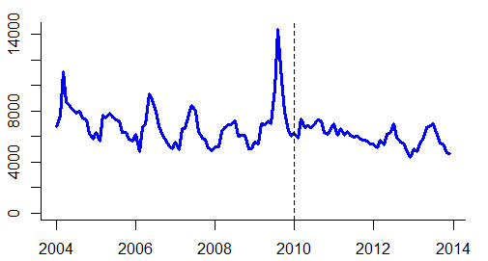
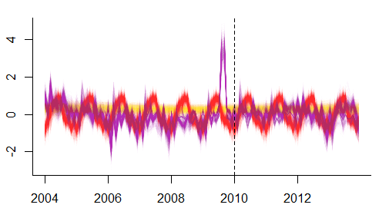
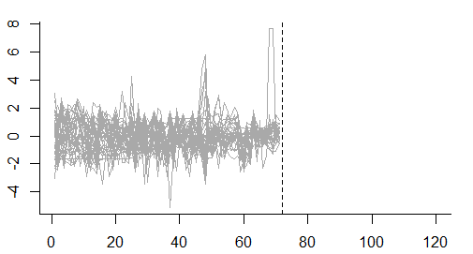
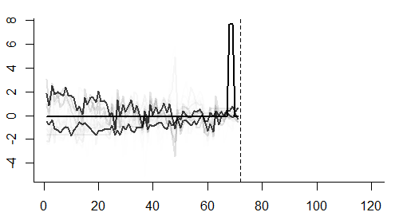
Original pneumonia time series
Regression model (and forecasts) include the synthetic control, seasonal variations, and random changes
Potential control variables
Training period
Evaluation
Controls are weighted based on similarities to pneumonia pre-PCV

Slide 27
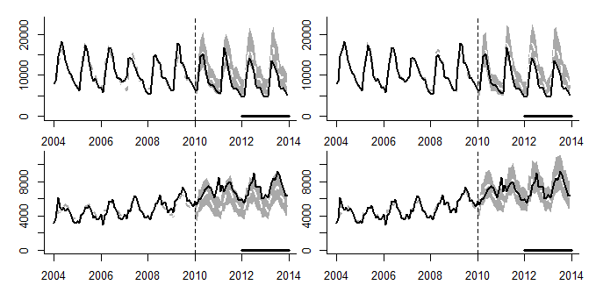
Example: Pneumonia in Brazil
Adjust only for non-respiratory hospitalizations
Adjust for synthetic control
A
B
<12 months
-23% (-30%,-16%)
-25% (-33%,-16%)
C
D
12-23 months
80+ years
+21% (+13%,+30%)
-0% (-12%,+14%)
-Synthetic controls do not affect estimates for <12month old children (no hidden biases detected)
-In adults >80, without synthetic control, would estimates a 21% increase, with synthetic control, no change

Slide 28
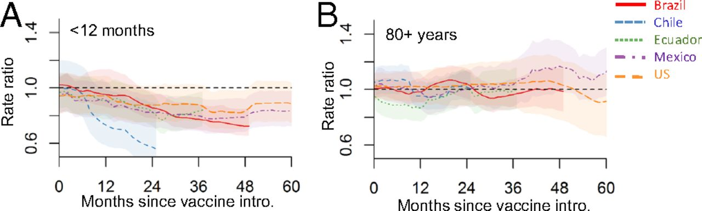
Trajectory of declines in five countries

Slide 29
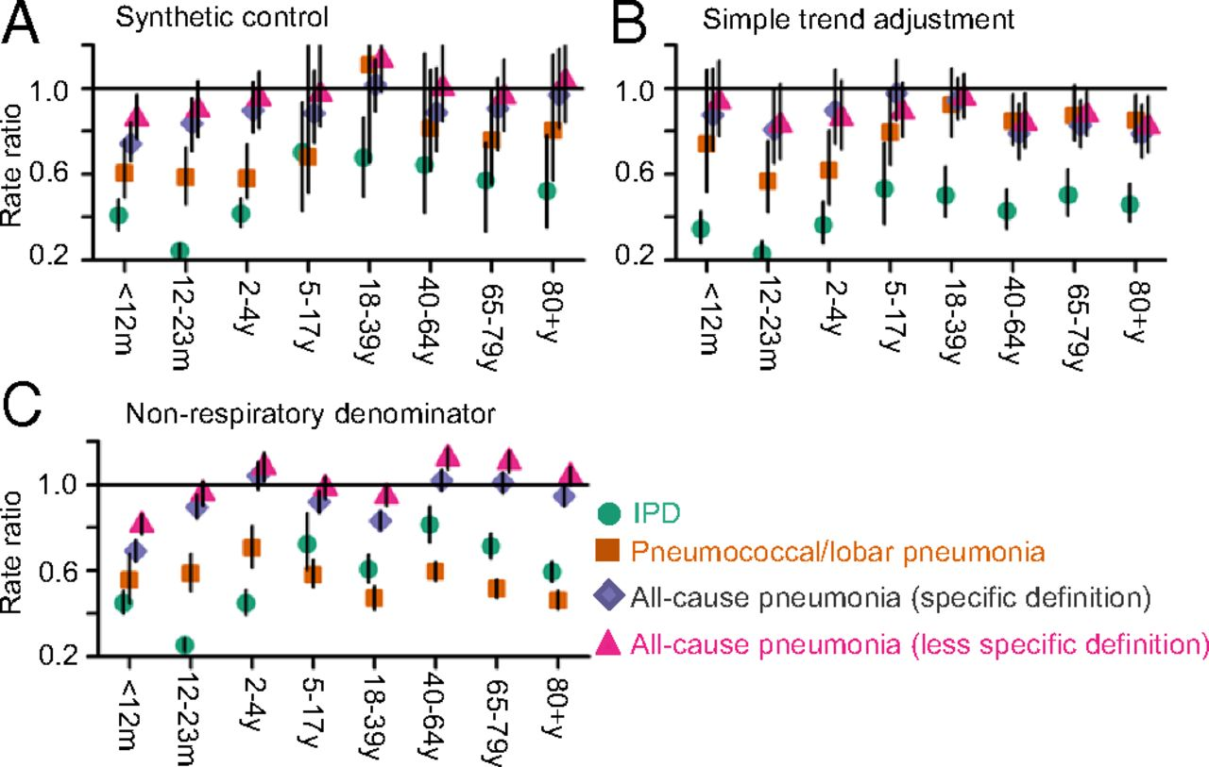
Impact of PCVs against outcomes of varying specificity
Simple trend adjustment
Synthetic control

Slide 30
Sensitivity analyses that are good to run
If have 6 years of pre-vaccine data, fit model to first 5 years, estimate “rate ratio” for 5th year
Should be ~1
Try dropping top 1,2,3 control variables; see if estimates change

Slide 31
Synthetic Controls: Pros and Cons
Provides flexible and robust approach to estimate vaccine impact
2 strong assumptions
None of the controls are influenced by the vaccine
The relationship between pneumonia and the controls does not change over time
Modifications needed for optimal use in small populations
Doesn’t guarantee you will detect/adjust for all confounding, but it increases the chances of success

Slide 32
What if we can’t identify appropriate controls because the data are too noisy?

Slide 33
Issues with Sparse Data
National:
PCV
Hard to assess correlations between the outcome and control diseases when data are noisy
Outcome
Controls
No. of cases (standardized, log)
SC model fails to select appropriate control disease(s) and generates unreliable prediction
What if we only observe 0.25% of cases? (ie small state in Brazil)
Outcome
Controls
No. of cases (standardized, log)
Notes:
A41: Other sepsis
I00_99: Diseases of the circulatory system

Slide 34
RRs from 100 down-sampled hospitalization datasets, 80+ yo in Brazil
National estimate of RR = 0.95
(represented by red dashed lines below)
Down sampling rate = 10%
Red dashed line: RR = 0.95 (national estimate)
Black line: RR = 1
100 down sampled datasets
RR

Slide 35
RRs from 100 down-sampled datasets
Not only CIs became wider but also RRs were biased away from the null
National estimate of RR = 0.95
(represented by red dashed lines below)
Down sampling rate = 10%
1%
0.25%
100 down sampled datasets
RR
RR
RR

Slide 36
Solution: smooth the control diseases

Slide 37
Sparse Approach
Control disease (I00_99)
Control disease (A41)
…
Control disease (G00_99_SY)

Slide 38
Sparse Approach
Step 1: Decomposition
Control disease (I00_99)
Trend
Seasonality
Remainder
Control disease (A41)
…
…
Control disease (G00_99_SY)

Slide 39
Step 2: Obtain a consensus trend
Step 1: Decomposition
Control disease (I00_99)
Trend
Seasonality
Remainder
Control disease (A41)
Consensus trend
…
…
Control disease (G00_99_SY)

Slide 40
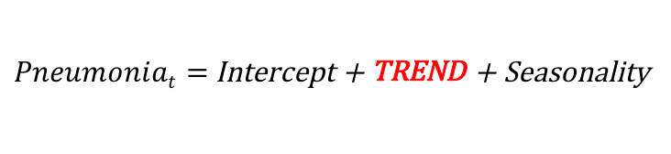
Step 1: Decomposition
Step 2: Obtain a consensus trend
Control disease (I00_99)
Trend
Seasonality
Remainder
Control disease (A41)
Consensus trend
…
…
Control disease (G00_99_SY)
Step 3: Regression
$Pneumoniat=$Intercept + TREND + Seasonality

Slide 41
 | Down samp. rate = 10% | 1% | 0.25%
SC model
New sparse approach
RRs are biased as data become sparse
RR
RRs are not biased. National estimate of RR is included in credible intervals
RR

Slide 42
Improved accuracy of sparse data approach
Down-sampling analysis
Simulation
SC model: Error increased as the data became sparse
Mean squared error
Sparse approach: Error remained small
Mean squared error
(sparse approach)
(sparse approach)

Slide 43
Reduced bias (Brazil state-level analysis, 80+ yo)
Synthetic controls data approach
Sparse data approach
Average number of pneumonia hospitalizations per year

Slide 44
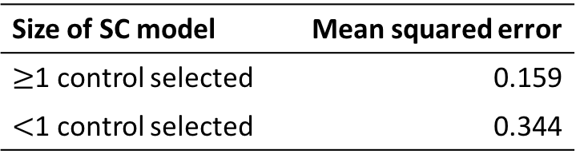
Among 100 down-sampled datasets, 4 successfully captured national estimate
RR
National RR
How were these 4 different from others?
Size of SC model | Mean squared error
$≥$1 control selected | 0.159
$<$1 control selected | 0.344
No. of control diseases selected in the SC model

Slide 45
Which analytical method is best?
Using a control disease is critical
Avoid simple time trend adjustment
At a minimum, adjust for all-cause mortality/hospitalization
If at least 1 control disease identified, use the results from synthetic controls
If no control diseases identified, it is often because the data are too sparse: use sparse data approach

Slide 46
Dan Weinberger, PhD and Kayoko Shioda, DVM, MPH
Epidemiology of Microbial Diseases at Yale School of Public Health
Flow Chart for Time Series Analysis of Pneumonia from admin data
Q1. Do you have at least 4 years of pre-vaccine data?
No
Be very cautious. It will be difficult to distinguish long-term trends from vaccine effects
Yes
Q2. Do you have control diseases?
No
Do simple interrupted time series analysis; as a sensitivity analysis, do change point analysis, block bootstrapping, etc.
Yes
Q3. Does the synthetic control method identify at least 1 control disease?
No
Use STL+PCA* , or alternative method to adjust trends
Yes
Use estimates from synthetic control method; as a sensitivity analyses, drop one control at a time
*STL+PCA: seasonal-trend decomposition based on LOESS + principal component analysis

Slide 47
Resources for using synthetic controls with administrative data
R package:
https://github.com/weinbergerlab/InterventionEvaluatR
Interface: dev.interventionevaluatr.com
Tutorial from Google
https://google.github.io/CausalImpact/CausalImpact.html
Original Google Paper
https://static.googleusercontent.com/media/research.google.com/en//pubs/archive/41854.pdf

